Slide 1


Prospecting methods & Process
Presented By:
Rtn.P.S. Ravindiran,
L.I.C. Associate
9444407791 ; 8825414550

Slide 2
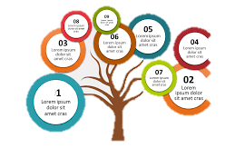
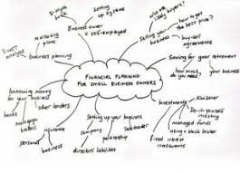
Ways Of Presentation
Linear Presentation
Text Presentation
Sum Assured = 10,00,000
Maturity = 18,00,000
Natural Death Cover = 10,00,000
And so on
Mind Map Presentation
Tree Presentation

Slide 3
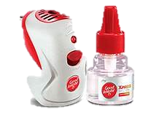
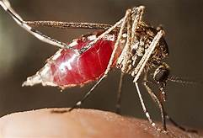
Effect Of Picturisation
A mosquito repellent representative tells
“Mosquito sucks blood from our body”
No one could imagine or visualize the effect
It will be definitely an information
Ie. Words can’t give the impact or enjoyment
Hence many will not buy
Whereas, if he shows the impact or benefit, people will be tempted to buy
This method applies for insurance also

Slide 4

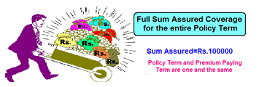

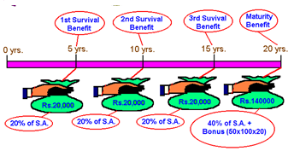
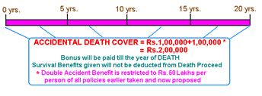
Ways Of Presentation
Picturisation Presentation
My initial stage of presentations

Slide 5

Ways Of Presentation
Picturisation Presentation
People Will Confuse & Demotivate Your Action

Slide 6


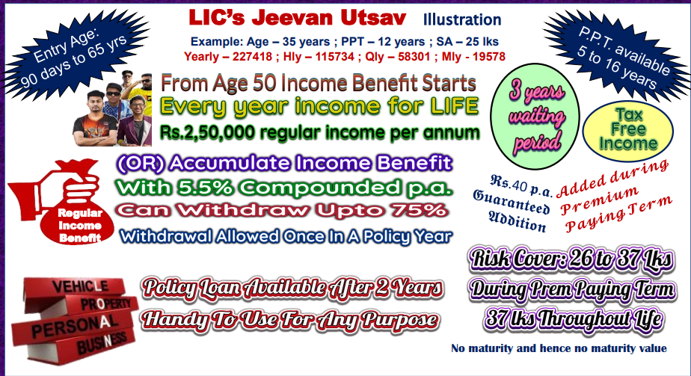
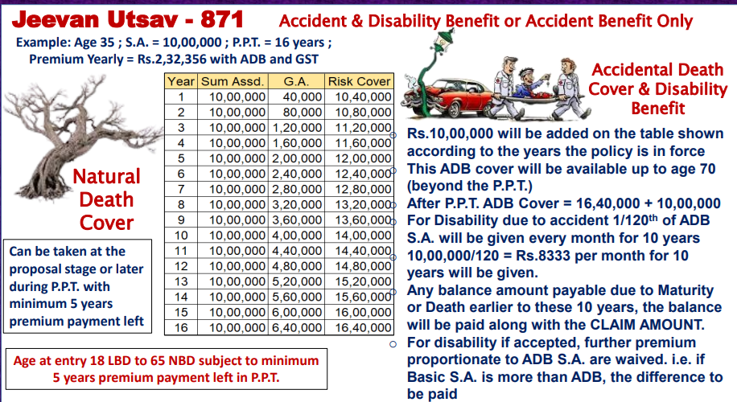
My Latest Way Of Presentations

Slide 7
Gathering Information First
Your name,
Date Of Birth & Income
Spouse name,
Date Of Birth & Income
Children name,
Date Of Birth (Son or Daughter)
Do you own house?
Do you have pension?
And so on

Slide 8




Effect Of Insurance
Human Life Span Pyramid
THAT IS THE POWER OF INSURANCE
Get married & children too come
Family will come back to comfort
X
X
Luxury
Suppose he dies
Suppose he dies
Excess Money
Man & Money at work goes
Comfort
Hand to mouth
Poor
Depending on others
Dependent
Family pushed to this bottom most stage
If insurance money is pumped in

Slide 9

Create & Save
HUMAN
L I VE VA L UE
This protects the HLV as and when premium paid
Best method for FAMILY PROTECTION
Taking a policy for HLV
In case of DEATH
LIC gives Sum Assured + Bonus
This portion also available for your loved ones
Earning Life Span

Slide 10



Save & Create
You left PEANUTS
Dad! How can we go to school
HUMAN
L I VE VA L UE
Then What about our future?
In case of DEATH
Comparing LIC, this may be better with other savings
But this portion will not be available for your loved ones
Earning Life Span

Slide 11



conclusion
In an adverse situation over confidence might lead to brain malfunction or totally crippled
Wearing helmet gives protection & doesn’t mean every rider will meet with an accident
Have right LIC policy for FAMILY SAFETY

Slide 12
HOW TO CALCULATE HUMAN LIFE VALUE
..\..\Videos\Human Life Value.mp4
H.L.V. another easy method
Income = 6,00,000 p.a.
Deposit interest rate = 6% p.a.
To get 6 lks p.a., how much deposit needed?
= (600000*100)/6 = 1,00,00,000 One crore
10% of income can be set aside for life insurance
= 60,000 p.a. and 5,000 p.m.
New Jeevan Amar ; Age 35 ; S.A. 1 Cr ; Yearly Premium 28366 ( Rs.2370 p.m.)
By reducing the Jeevan Amar S.A. and add a conventional plan, so as to tally with Rs.5,000 p.m. for life insurance
Jeevan Anand 10,00,000 Yly 47784 ; Jeevan Amar 50,00,000 Yly 17916
Total cover 60 lakhs and total premium 65700
Just a food for thinking and you can do any manner as your like and party likes

Slide 13
CONCEPT SELLING - PENSION
Actually, Indian life expectancy is age 83 on an average
Age 35
Retirement
Age 55
Till Life
Inflation Rate 7%
Today Living Expense
Rs. 4,80,000/-
Min. Yearly Income with inflation Rs. 18,57,448/- for Life
Corpus Needed
Rs. 3 crs appx.

Slide 14
CONCEPT SELLING - PENSION
Creation of corpus is certain with
LIFE INSURANCE and others God only knows
Corpus
Rs. 3,00,00,000
Return 8%
1. Post Office
2. Bank Rd
3. Life Insurance Policy
Return 15%
1. Real Estate
2. Gold
3. Mutual Fund
Contribution of
Every Year Rs.6,55,000
Contribution of
Every Year Rs.2,71,000

Slide 15
CONCEPT SELLING - PENSION
Jeevan Anand ; S.A. 1.55 cr ; Term 20 years ; Yearly Premium 9,06,799 with GST
Maturity Value Rs.2,96,95,000 appx
Age 35
Age 55
Death
Term = 20 years
Invested in Jeevan Akshay
Yearly Pension = Rs.18,70,000
(with today J.A. rate)
Maturity Value
Rs.3,00,00,000
approximately
Annuity for LIFE with
Return Of Purchase Price
Jeevan Anand Death Benefit
+ Jeevan Akshay Corpus
= 1,55,00,000 +3,00,00,000
= Rs.4,55,00,000

Slide 16
Jeevan Anand Table 915
Jeevan Anand ; S.A. 1.55 cr ; Term 20 years ; Yearly Premium 9,06,799 with GST
Maturity Value Rs.2,96,95,000 appx
Age 35
Age 55
Death
Natural Death Cover = 125% S.A. Rs. 1,93,75,000 + Accrued Bonus
Either Natural or Accidental Death Cover = Rs.1,55,00,000
Accidental Death Cover = Rs. 2,93,75,000 + Accrued Bonus
Subject to other ADB previous policies
End of this module

