Slide 1








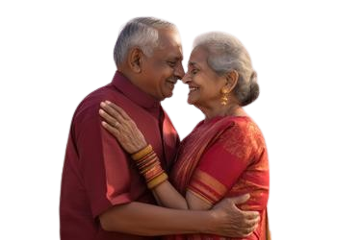

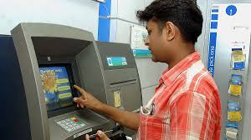




Table 871
Rs.40 Guaranteed Addition
First 4 slides can be used for demo purpose

Slide 2

Table 871
The only portfolio in the country have a short period of payment
Guaranteed Income for LIFE
Risk Cover till LIFE with Guaranteed Addition till P.P.T.
With
Cash liquidity by way of withdrawal
Cash liquidity by way of Policy Loan
Rider Benefits beyond Premium Paying Term

Slide 3








Slide 4












Table 871
Grandfather or Parents can gift
Child Life with Ease
Guaranteed Income of
Rs.2.5 Lakhs p.a.
Jeevan Utsav a great plan
My daughter is paying college fees from Guaranteed Income
With ease
I could finish my GRADUATION
I could put
both the children in SCHOOL
I took when she was 3 years old
She is receiving Rs.2,50,000 p.a.
I paid Rs.2,01,986 p.a. for 13 years for a Sum Assured of Rs.25 lakhs
Gives Life Long protection of Rs.38 Lakhs
Thanks Appa for your VISIONARY THOUGHT
It works as PENSION
We live peaceful retired life

Slide 5













LIC’s Jeevan Utsav
Illustration
Entry Age:
90 days to 65 yrs
Age – 35 years ; PPT – 13 years ; SA – 25 lks ; Yearly – 2,03,514
P.P.T. available 5 to 16 years
Waiting Period 2 years
Tax Free Income
𝕽𝖘.40 𝖕.𝖆. 𝕲𝖚𝖆𝖗𝖆𝖓𝖙𝖊𝖊𝖉 𝕬𝖉𝖉𝖎𝖙𝖎𝖔𝖓
𝓐𝓭𝓭𝓮𝓭 𝓭𝓾𝓻𝓲𝓷𝓰 𝓟𝓻𝓮𝓶𝓲𝓾𝓶 𝓟𝓪𝔂𝓲𝓷𝓰 𝓣𝓮𝓻𝓶
Regular Income Benefit
No maturity and hence no maturity value

Slide 6
From now onward slides purely for field force training purpose
How I.T. Sec. 10(10D) Works?
The Risk Cover in Jeevan Utsav is 7 times of Annualised Premium or 105% of Premium Paid or Basic Sum Assured, whichever is higher will be extended.
In short-term policies mostly 7 times of annualised premium will be taken
In long-term policies mostly the Basic Sum Assured will be taken
To avail the Sec. 10(10D) benefit the annualised premium should not exceed 10% of the Risk Coverage
Ex: Age 30, PPT 5 years, B.S.A 10,00,000, Premium Yearly 2,17,800 (Basic)
Risk cover: 7 times of annualised premium = 15,24,600
The yearly premium is more than 10% of Risk Coverage (10%=1,52,460)
Hence a TDS of 2% will be deducted from the Yearly Survival Benefit
To overcome add Term Assurance Rider for 10,00,000
Then the risk cover = 15,24,600+10,00,000 = 25,24,600
By this the yearly premium will be less than 10% of Risk Cover

Slide 7
How I.T. Sec. 10(10D) Works?
Annual Premium In Excess Of 5 Lakhs
Under this new regulation, any proceeds received from a life insurance policy with an annual premium exceeding INR 500,000 will be subject to taxation. As a result, section 10(10) of the Income Tax Act, previously offering exemptions, will no longer apply to policies with premiums surpassing this threshold.19 Aug 2023
Age 35 ; S.A. 65,00,000 ; PPT 13 years ; Basic Yearly Prem 5,02,775
As per new I.T. rule the maturity proceeds are taxable
But in Jeevan Utsav it is being given as Survival Benefits every year
The rule anything over the total basic premium paid is taxable
The total premium paid is Rs. 6536075
So first 10 years S.Bs. are exempted from TDS and rest will be deducted
6536075 / 650000 = 10
End of today’s session and Jeevan Utsav will be continued in next session

Slide 8
Jeevan Utsav - 871
Basic Terms & Conditions
Age: 90 days to 65 NBD
Waiting Period
Premium Paying Term
Life Time Income Benefit @ 10% of Sum Assured
5 to 16 years
2 to 5 years depending on age at entry
For minor life the PPT should be completion of age 18 to receive the 1st Survival Benefit
Note: Apart from plans, some technical terms I would like to elaborate as this as training session, even newly joined LIC field force will be here
NBD = Nearer Birth Day.
Ie. Date Of Completion (DOC), if it lies in first 6 months from the date of birth lower age should be taken. If it lies in the 2nd 6 months higher age should be taken
Ex: Today 10/12/2023 ; Date Of Birth (DOB) 02/06/1980. Then as on today the age is 8 days, 6 months and 43 years.
Up to 6 months lower age should be taken. Since the above is more than 6 months higher age should be taken. Ie. as on today the NBD is 44 years instead of 43 years

Slide 9
Jeevan Utsav - 871
Launched 29-11-23
Basic Terms & Conditions
The DOC can be shifted to earlier days, which is called BACK DATING.
Back Dating can be done from 1st April of current financial year but not earlier to date of launch of new plans. Since the date of launch of Jeevan Utsav is 29-11-23, if we back date the excess 8 days, then the age NBD will be 43 only. The Backing Dating should be from 29-11-2023 to 30/11/2023 to get 43 LBD
LBD = Last Birth Day. Only completed years should be taken as age. Ie as on today the age is 43 LBD only. Whatever days and months should be ignored
Generally for minors LBD should be taken.

Slide 10
Jeevan Utsav - 871
Income Benefit & Waiting Period
No Maturity Benefit
Age: 90 days to 65 NBD
Waiting Period
Premium Paying Term
5 to 16 years
Life Time Income Benefit @ 10% of Sum Assured
2 to 5 years
Guaranteed Addition @ 40 per 1000 S.A. per policy year
Will be added at the end of each policy year, provided the whole year’s premium is paid
For Death G.A. will be added for the year of death immaterial of premium paid as the unpaid premium of P.Y. will be deducted from death proceed

Slide 11
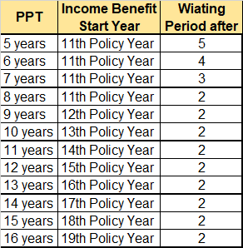
Jeevan Utsav - 871
Income Benefit & Waiting Period
Two options available to receive Income Benefit
Regular Income payable every year
Flexi Income: Can accumulate the Income Benefit
Flexi Income will yield 5.5% compounded p.a.
Once in a policy year maximum 75% can be withdrawn from the accumulated amount
No maturity and hence no maturity value
What is Policy Year of a particular policy?
Let us take a 15 years policy term with D.O.C. as 1-7-24
1st Policy Year = 1.7.24 to 30.6.25 (365 days)
2nd Policy Year = 1.7.25 to 30.6.26
3rd Policy Year = 1.7.26 to 30.6.27 and so on and will have 15 policy years
For Surrender proportionate completed months of the P.Y. will be taken into account

Slide 12
Jeevan Utsav - 871
Natural Death Cover: Basic Sum Assured or 105% of total premium paid or 7 times of annualised Basic Premium
Basic Terms & Conditions
Basic Premium means Tabular Premium * Sum Assured
Any additions and discounts will not be taken into account inclusive of riders
Death Benefit can be taken in instalments of Mly/Qly/Hly/Yly for period of 5 or 10 or 15 yrs
Accidental Death Cover, if opted: Natural Death Cover + Accident Death Sum Assured
Disability Benefit Due To Accident: If ADB opted, 1/120yth ADB S.A. will be payable every month for another 10 years
Disability Benefit: Unpaid DAB benefit due to maturity or death, the balance will be paid along with claim amount
A.D.B. cover available till age 70, immaterial of Premium Paying Term
Accident Death Benefit only or Accident Death with Disability, either one can be opted
Accident Death Cover available till P.P.T. only

Slide 13
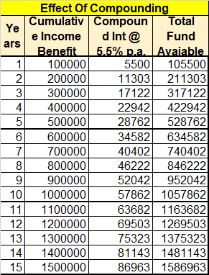
Jeevan Utsav - 871
Basic Terms & Conditions
Guaranteed Addition of Rs.40 per 1000 Sum Assured payable every year during the Premium Paying Term only
Example: Age 35 ; S.A. = 10,00,000 ; P.P.T. = 16 years ; Premium Yearly = Rs.2,32,356 with ADB and GST
Age: 35 NBD
Age: 51
Age: 54
Till Life
Premium Paying Term = 16 years
Waiting Period
Life Time Income Benefit @ 10% of Sum Assured
Regular Income: Rs.1,00,000 payable every year throughout LIFE.
Flexi Income:
Rs.1,00,000 every year will be added and it is being accumulated with 5.5% compound interest per annum
From accumulated amount maximum 75% is allowed to withdraw, once in a policy year as and when one requires
Risk Cover: Rs.16,40,000 from age 51 to LIFE (constant)

Slide 14
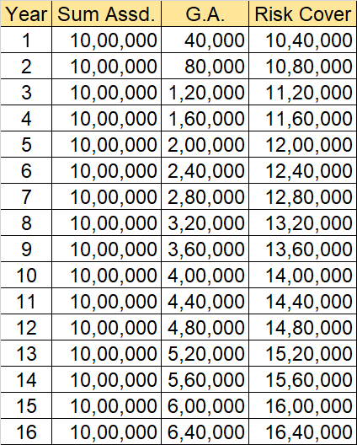


Jeevan Utsav - 871
Accident & Disability Benefit or Accident Benefit Only
Example: Age 35 ; S.A. = 10,00,000 ; P.P.T. = 16 years ; Premium Yearly = Rs.2,32,356 with ADB and GST
Natural Death Cover
Can be taken at the proposal stage or later during P.P.T. with minimum 5 years premium payment left
Age at entry 18 LBD to 65 NBD subject to minimum 5 years premium payment left in P.P.T.

Slide 15

Jeevan Utsav - 871
Accident & Disability Benefit or Accident Benefit Only
Example: Age 35 ; S.A. = 10,00,000 ; P.P.T. = 16 years ; Premium Yearly = Rs.2,32,356 with ADB and GST
Accidental Death Cover & Disability Benefit
Rs.10,00,000 will be added on the table shown according to the years the policy is in force
This ADB cover will be available up to age 70 (beyond the P.P.T.)
After P.P.T. ADB Cover = 16,40,000 + 10,00,000
For Disability due to accident 1/120th of ADB S.A. will be given every month for 10 years
10,00,000/120 = Rs.8333 per month for 10 years will be given.
Any balance amount payable due to Maturity or Death earlier to these 10 years, the balance will be paid along with the CLAIM AMOUNT.
For disability if accepted, further premium proportionate to ADB S.A. are waived. i.e. if Basic S.A. is more than ADB, the difference to be paid

Slide 16
Death within 180 days from the date of accident will only be entertained
In case of Accident Disability occurs within 180 days from the date of accident an amount of 1/120 the of A.D.B. S.A. is payable for every month for 10 years
Further premium proportionate up the A.D.B. S.A. will be paid.
Ie. If the Basic S.A. is more than that of A.D.B. S.A., then the proportionate premium of the difference has to be paid till P.P.T.
If death or maturity falls within these 10 years then the balance payable of Disability Benefit will be paid
The disability should be total and permanent due to accident
If any 4 out of 6 mentioned below are satisfied then the disability benefit is payable

Slide 17
The Activities of Daily Living are, which 4 out of 6 can’t be performed
Dressing: The ability to put on and take off all necessary garments, artificial limbs or other surgical appliances that are medically necessary
Washing: The ability to wash to maintain an adequate level of cleanliness and personal hygiene
Feeding: The ability to transfer food from a plate or bowl to the mouth once the food has served and available to eat
Toileting: Ability to use lavatory or otherwise manage bowel and bladder functions so as to maintain a satisfactory level of personal hygiene
Mobility: The ability to move indoors from room to room on level surfaces at the normal place of residence
Transferring: The ability to move from bed to an upright chair or wheel chair and vice versa

Slide 18


Jeevan Utsav - 871
Add On Cover
Age: 35 NBD
Age: 51
Age: 54
Age 75
Premium Paying Term = 16 years
Waiting Period
Life Time Income Benefit @ 10% of Sum Assured
Term Assurance Rider Cover Period
BASIC RISK COVER During P.P.T.
General conditions of Term Assurance Rider
It should be taken at the time of proposal and will not be entertained later
The T.R. S.A. should be equal to Basic Sum Assured or less and the total T.R. S.A. taken already with this T.R. S.A. should not exceed Rs.25 lakhs per person
Available from age 18 LBD to 60 and maximum cover ceasing age 75 NBD. Ie minor life not eligible.
The term allowed is 35 years or ceasing age 75 NBD, whichever earlier. Ie. This cover is extended beyond PPT also
₊
Rs.10,00,000, if it is taken will be added on Risk Cover as shown in the table
After PPT till life the Risk Cover will be 26,40,000 till age 70
If ADB is added for 10 lks, the Accidental Risk Cover will be 36,40,000 till age 70. If A.B. alone only available till PPT

Slide 19


Jeevan Utsav - 871
Age: 35 NBD
Age: 51
Age: 54
Age 75
Premium Paying Term = 16 years
Waiting Period
Life Time Income Benefit @ 10% of Sum Assured
Critical Illness Cover Period
General conditions of Critical Illness Rider
Available at the inception level, Ie. Proposal stage only and if opted available till age 75
Available for 15 illness as listed in circular
Available for a maximum of 35 years or age 75 NBD, whichever is earlier. Available beyond PPT.
Age group: 18 LBD to 65 NBD
The CIR S.A. should be less than or equal to Basic S.A. subject to further restriction of total 25 lakhs of all policies cover earlier with CIR and this is per person
Let us take Rs.10,00,000 the B.S.A. is taken for CIR also
Then if accepted Rs.10,00,000 will be paid immaterial of expenses incurred
Original copy of Hospital Discharge Summary should be given along with some other xerox copies of prescription or bills paid
The C.I.R. premium only will be waived and the rest has to be paid.
Added advantage the L.A. can claim with any other Mediclaim policy, if taken.

Slide 20

The Critical Illness covered under this rider:
Cancer of Specified Severity
Open Chest CABG
Myocardial Infarction
Kidney failure requiring regular dialysis
Major organ / bone marrow transplant (as recipient)
Stroke resulting in permanent symptoms
Permanent paralysis of limbs
Multiple sclerosis of limbs
Aortic surgery
Primary (idiopathic) pulmonary hypertension
Alzheimer’s disease / damentia
Blindness
Third degree burns
Open heart replacement of repair of heart valves
Benign brain tumour
Still 8 more slides available to add
The end

